Slide 1
Module 2: Mandated Tasks of United Nations Peacekeeping Operations
Lesson
2.5
Protection of Civilians

Slide 2
Relevance
Protection of Civilians (POC) is:
A priority for the Security Council
A responsibility for all peacekeeping personnel
UN Core Pre-Deployment Training Materials 2017

Slide 3
Learning Outcomes
Learners will:
Explain the POC mandate
List examples of threats civilians face in armed conflict
Describe the range of protection partners that operate alongside UN peacekeeping operations
Explain the DPKO-DFS Operational Concept
List actions to implement the POC mandate
UN Core Pre-Deployment Training Materials 2017

Slide 4
Learning Overview
Definitions
Importance of POC
Legal Framework
Protection Partners
DPKO-DFS Policy on POC
DPKO-DFS Operational Concept on POC
Implementing the POC Mandate
Roles & Responsibilities
What Individual Peacekeeping Personnel Can Do
UN Core Pre-Deployment Training Materials 2017

Slide 5
Learning Activity
2.5.1
Critical Incidents: Bystander or First-Responder?
Instructions:
Consider the images of critical incidents
What would you do?
Compare with threats to civilians in armed conflict
Time: 5 minutes
Brainstorming: 3 minutes
Discussion: 2 minutes
UN Core Pre-Deployment Training Materials 2017

Slide 6
1. Definitions
POC Mandate
“All necessary means, up to and including the use of deadly force, aimed at preventing or responding to threats of physical violence against civilians, within capabilities and areas of operations, and without prejudice to the responsibility of the host government”.
UN Core Pre-Deployment Training Materials 2017

Slide 7
Learning Activity
2.5.2
Standard Mandate Language
Instructions:
Explain “threats of physical violence”
Explain “all necessary means”
Explain “use of deadly force (as a last resort)”
Explain “responsibility of the host government”
Time: 5 minutes
Brainstorming: 3 minutes
Discussion: 2 minutes
UN Core Pre-Deployment Training Materials 2017

Slide 8
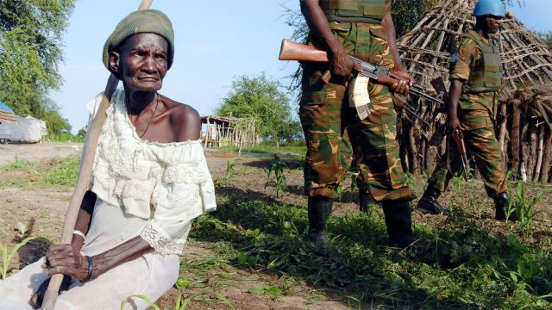
Civilian
Any person who is not or is no longer directly participating in hostilities or other acts of violence
UN Core Pre-Deployment Training Materials 2017

Slide 9
Threats
To life | Arbitrary, summary or extrajudicial executions Murder (from individual killings, to systematic violence and genocide)
To physical integrity | Torture, cruel, inhuman or degrading treatment Rape and other forms of sexual violence (from opportunistic, to widespread and systematic use) Abduction Deliberate deprivation (of food, water, other goods or services necessary for survival)
To freedom | Forced disappearance Arbitrary/illegal arrest and detention Restrictions on freedom of movement (including forced displacement) Forced labour or recruitment
To property | Theft, extortion (e.g. illegal taxation) Looting
UN Core Pre-Deployment Training Materials 2017

Slide 10
Vulnerability Factors
Individual, community factors
Environmental factors
Access to assistance
Self-sufficiency
UN Core Pre-Deployment Training Materials 2017

Slide 11
Learning Activity
2.5.3
Vulnerability and Threats
Instructions:
Consider the case study
Identify the threats
Identify vulnerabilities of the civilian population
Which civilians are most vulnerable?
Time: 10 minutes
Group work: 5-7 minutes
Discussion: 3 minutes
UN Core Pre-Deployment Training Materials 2017

Slide 12
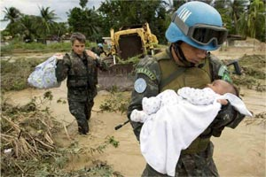
2. Importance of Protecting Civilians
Harmed unintentionally
Deliberate targets
Women and children suffer disproportionately
UN Core Pre-Deployment Training Materials 2017

Slide 13
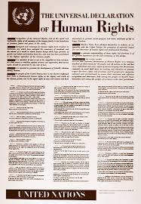
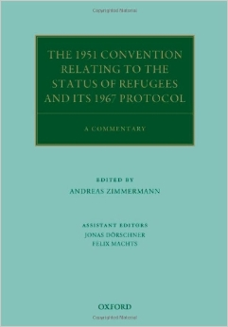
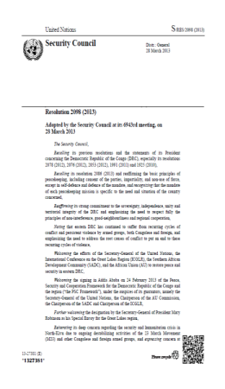
3. Legal Framework
International Law
Security Council resolutions
National laws
UN Core Pre-Deployment Training Materials 2017

Slide 14
4. Protection Partners
Host state government
Local communities
UN partners – UNHCR, OHCHR, OCHA, UNICEF
ICRC
Non-UN military forces
NGOs, civil society organizations – national, international
UN Core Pre-Deployment Training Materials 2017

Slide 15
5. DPKO-DFS Policy on POC
Guiding Principles
Primary responsibility of host government
Grounded in international law
Whole of mission approach
Priority mandate
Cooperation with humanitarian actors
Obligation of peacekeeping personnel
Community-based approach
Impartiality
Gender perspective and child protection concerns
UN Core Pre-Deployment Training Materials 2017

Slide 16
6. DPKO-DFS Operational Concept on POC
Three Tiers
Tier I: Protection through dialogue and engagement
Tier II: Provision of physical protection
Tier III: Establishment of a protective environment
UN Core Pre-Deployment Training Materials 2017

Slide 17
Four Phases of Response
Prevention
Threat is latent (risk)
Pre-emption
Threat is identified
Response
Consolidation
Threat has been mitigated/eliminated
UN Core Pre-Deployment Training Materials 2017

Slide 18
7. Implementing the POC Mandate
Threat Assessment & Risk Analysis
High
Threat B
Threat D
Impact
Threat C
Threat A
Low
Likelihood
High
UN Core Pre-Deployment Training Materials 2017

Slide 19
POC Response Planning
POC Strategy: Primary tool at mission level to implement POC mandate and plan responses to POC threats
Operational level guidance, joint action, coordination for all mission components
UN Core Pre-Deployment Training Materials 2017

Slide 20
Coordination with Protection Partners
National Authorities: | Political engagements; security sector reform programmes; targeted advocacy; joint operations or joint patrolling
Local Communities: | Dialogue with local population; mission-wide community engagement cooperation mechanisms such as Joint Protection Teams, Community Liaison Assistants, Community Alert Networks, localized protection strategies
Humanitarian Community: | Protection Cluster led by UNHCR
Parallel Forces: | Information sharing and operational planning on a case-by-case basis, including HOM exchanges and working-level cooperation
UN Core Pre-Deployment Training Materials 2017

Slide 21
Learning Activity
2.5.4
Four Phases of Response
Instructions:
Consider the case study
Assess the threat in more detail
Identify actions for the mission at each phase
Identify roles of military, police and civilians
Time: 10 minutes
Group work: 5-7 minutes
Discussion: 3 minutes
UN Core Pre-Deployment Training Materials 2017

Slide 22
8. Roles & Responsibilities
Protection Adviser
Supports and advises mission leadership
Development and regular review of mission-wide POC strategy
Advisory, coordination, monitoring & reporting role
Integrates POC concerns across the mission
Goal
Protection of Civilians
UN Core Pre-Deployment Training Materials 2017

Slide 23
Other Units
Women Protection Adviser
Child Protection
Human Rights
Gender Adviser
Civil Affairs
Political Affairs
Rule of Law/Judicial Affairs
SSR
DDR
JOC/JMAC
Public Information
Mission Support
DSRSG/RC/HC
SRSG’s Office
UN Core Pre-Deployment Training Materials 2017

Slide 24
Special Roles of Military & Police
Physical protection
Proactive approach
Monitoring and reporting
Protection of Civilians
UN Core Pre-Deployment Training Materials 2017

Slide 25
Joint Protection Teams
Coordinated by POC Adviser
Composed of military, police, civilians
Gathers information on protection situations
UN Core Pre-Deployment Training Materials 2017

Slide 26
9. What Individual Peacekeeping Personnel Can Do
Engage local communities
Understand POC mandate, environment, threats
Cooperate with mission components and partners
Interpret the POC mandate pro-actively, try to prevent threats
Respond, intervene
UN Core Pre-Deployment Training Materials 2017

Slide 27
Summary of Key Messages
POC mandate – all necessary means to prevent and respond to threats of physical violence against civilians
Threats to civilians – life, physical integrity, freedom, property from state/non-state actors
Protection partners – host state government, local communities, UNHCR, OHCHR, OCHA, UNICEF, ICRC, parallel forces, NGOs, CSOs
Take action – engage local communities, follow POC strategy, coordinate, intervene
UN Core Pre-Deployment Training Materials 2017

Slide 28
Questions
UN Core Pre-Deployment Training Materials 2017

Slide 29
Learning Activity
Learning Evaluation
UN Core Pre-Deployment Training Materials 2017

